Slide 1


RANDOM PASSWORD GENERATOR BY MANISH MISHRA

Slide 2
INTRODUCTION Random Password generator is a software tool that creates random or customized passwords for users. It also helps users to create stronger passwords that provides greater security for a given type of access.

Slide 3
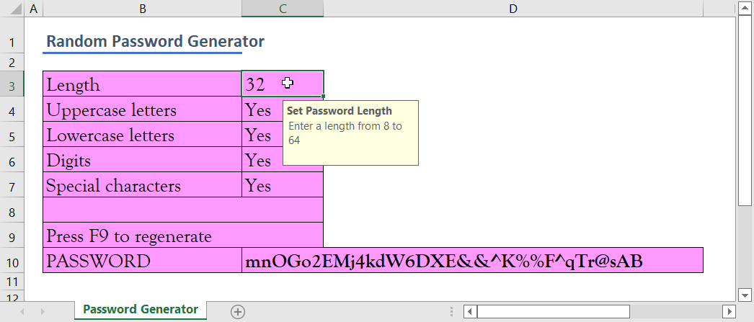
NEED OF PASSWORD GENERATOR
PASSWORD GENERATOR HELPS THOSE WHO HAVE TO CONSTANTLY COME UP WITH NEW PASSWORDS TO ENSURE UNAUTHORIZED ACESS FOR PROGRAMS AND TO MANAGE A LARGE NUMBER OF PASSWORDS FOR IDENTIFY AND ACCESS MANAGEMENT.

Slide 4
STEPS TO CREATE PROJECT
TO RUN THE CODE WE HAVE TO USE PYTHON IDLE.
IMPORT RANDOM FROM PYTHON LIBRARY.
GREET THE USER BY PRINT (“WELCOME TO YOUR PASSWORD GENERATOR”)
ASK THE USER TO ENTER AMOUNT OF PASSWORDS TO GENERATE AND PUT THE VARIABLE AS INTEGER.
TAKE ANY VARIABLE IN RANGE(LENGTH):
PASS THE COMBINED VARIABLE WITH FUNCTION(RANDOM) AND JOIN IN THE END TO GENERATE THE PASSWORD.
FINALLY ! LET’S PRINT THE PASSWORDS…

Slide 5
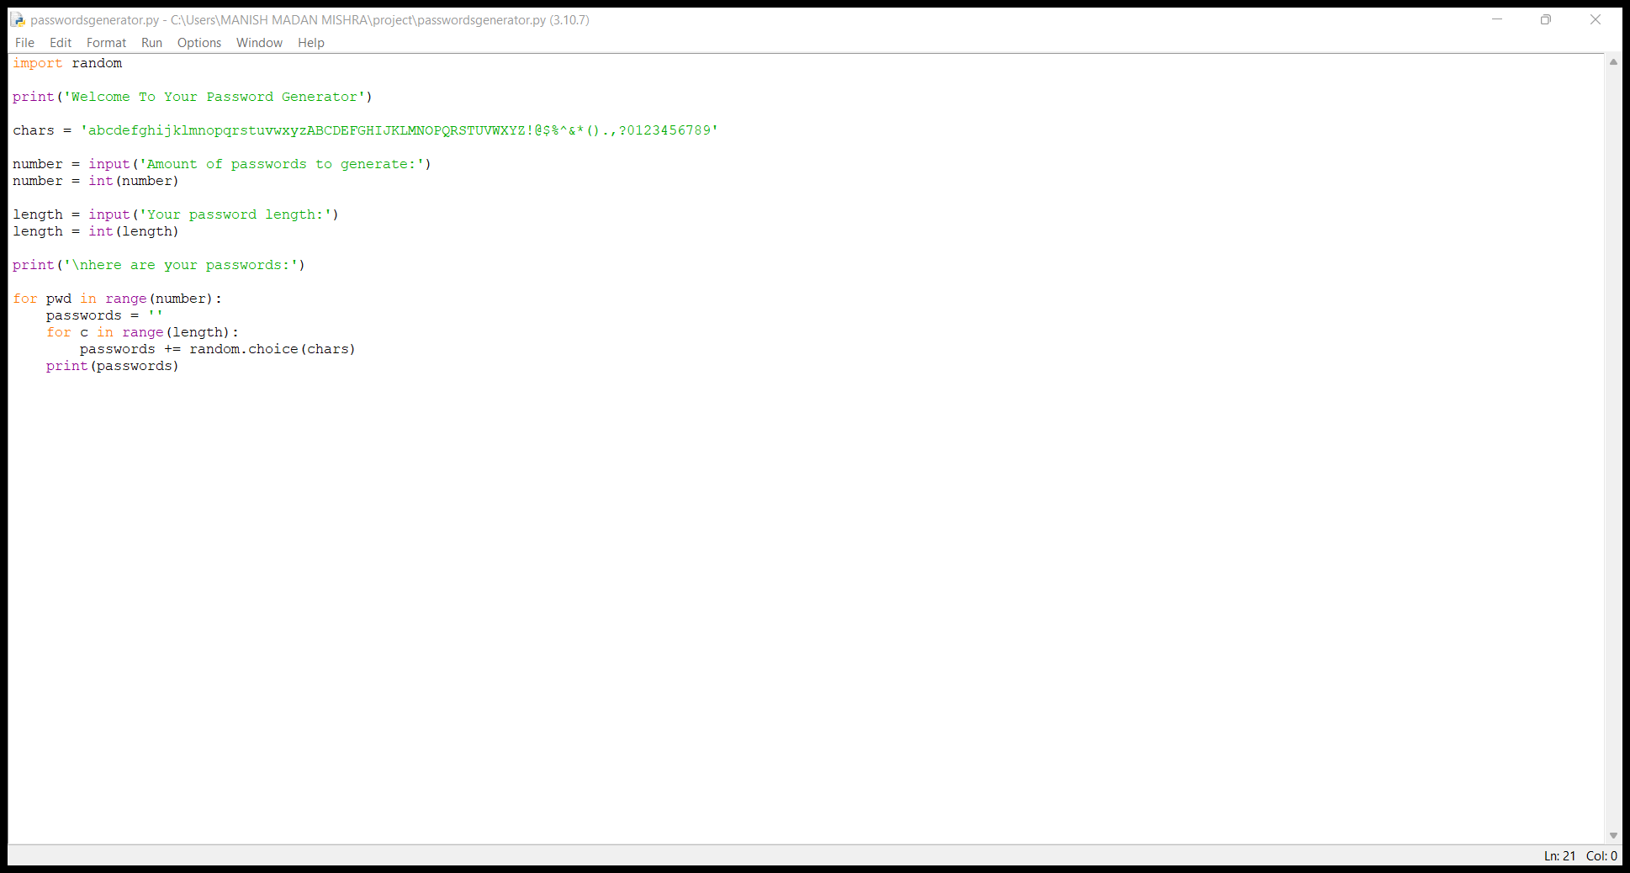
CODE OF THE PROJECT

Slide 6
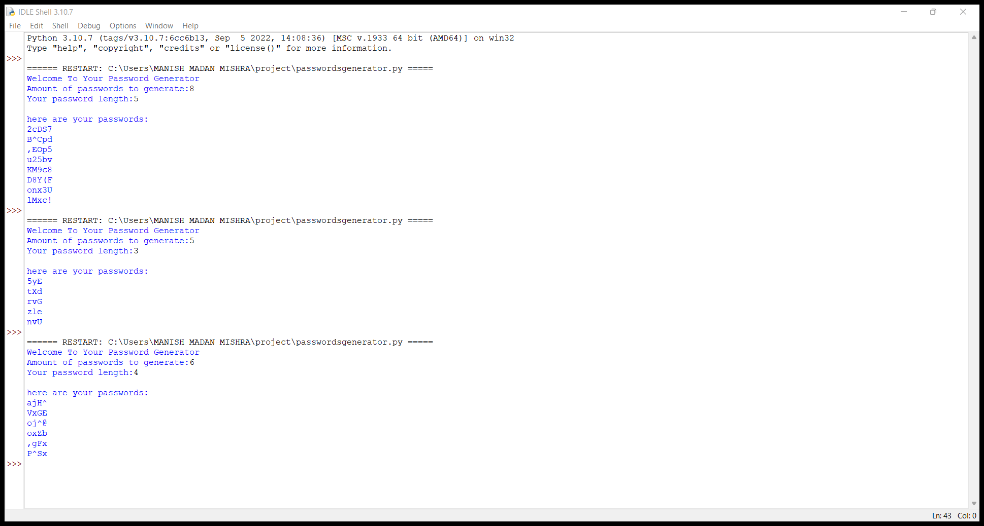
OUTPUT OF THE PROJECT

Slide 7
END OF PROJECT
THIS PROJECT WAS DONE BY MANISH MISHRA
THANK YOU.

